Slide 1

AI in FinTech
By MXK

Slide 2
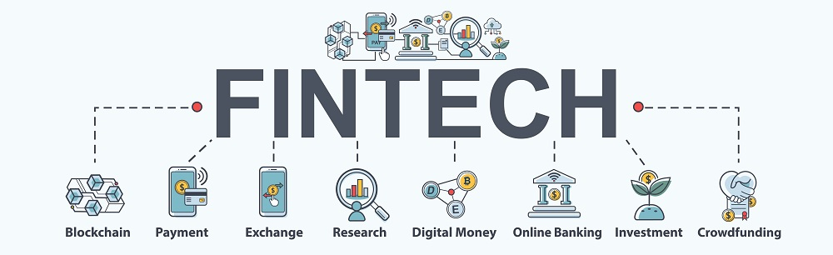

Slide 3
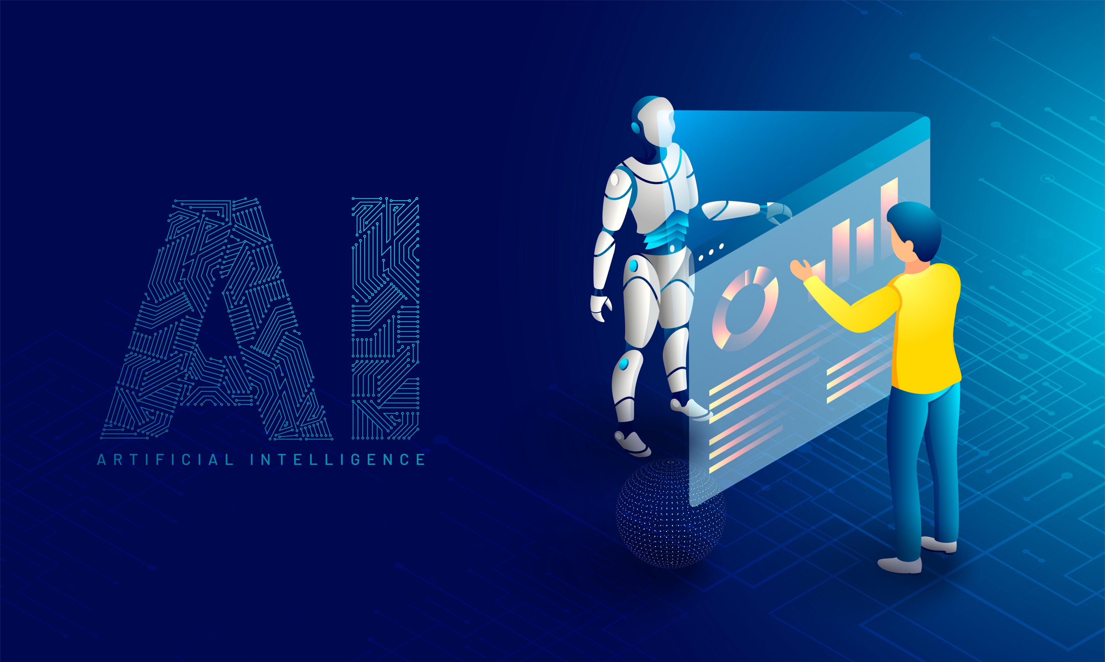

Slide 4


Slide 5
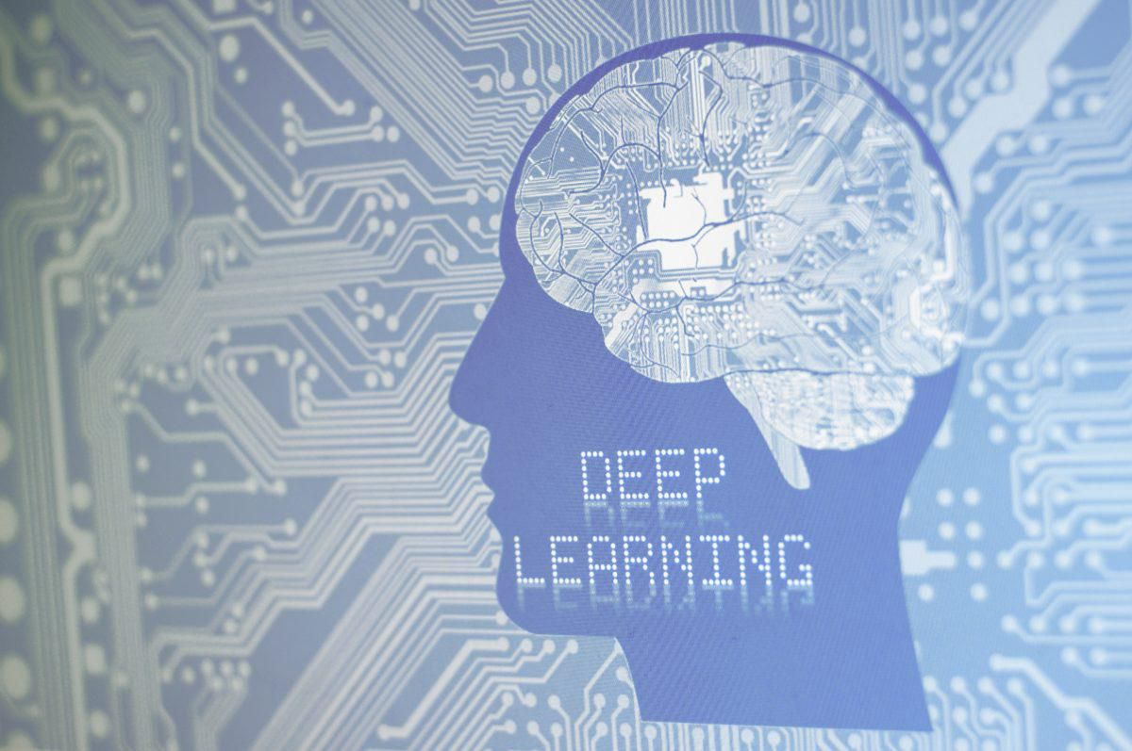

Slide 6


Slide 7

Workshop
Predict TAIR Stock Price
Workshop

